Slide 1
Advanced Front-End Programming (CPAN 144)
Week 12
Lecturer: Arman Hamzehlou Kahrizi
Winter 2023

Slide 2
Agenda
Deploying React app to Vercel

Slide 3
Serving a React app with Vercel
Rather than building the app manually before every production deployment and pushing the contents to a static web server, we can leverage modern services such as Vercel to automate this process.
Vercel will detect changes to our code and perform the build step for us automatically as well as host the built app on their server.

Slide 4
Steps 1 – Account Registration
Sign up for a free account at Vercel:
https://vercel.com/signup

Slide 5
Step 2 - Setup
First step is to install Vercel CLI :
npm i -g vercel
Vercel CLI Overview | CLI Commands | Vercel Docs

Slide 6
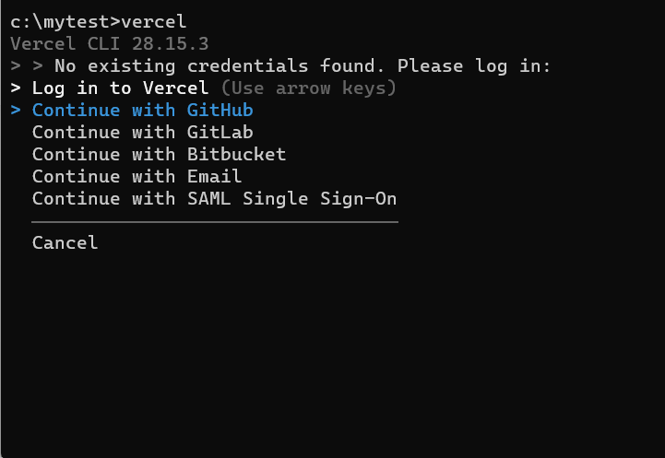
Step 3 - Deploying
Open up a terminal in your react project and type in vercel and press enter.

Slide 7
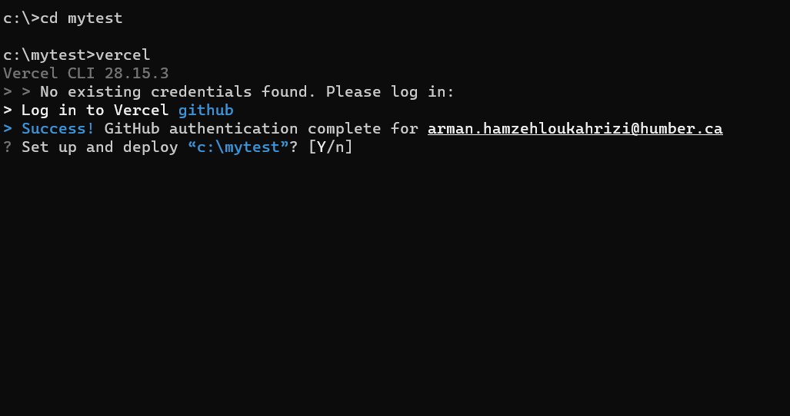
Steps 4 - Deploying
Select the appropriate login method, and follow the login process in a web browser. Once successful, you will be greeted with a success message

Slide 8
Step 5 - Deploying
Confirm with “y” that you are setting up and deploying the project.

Slide 9
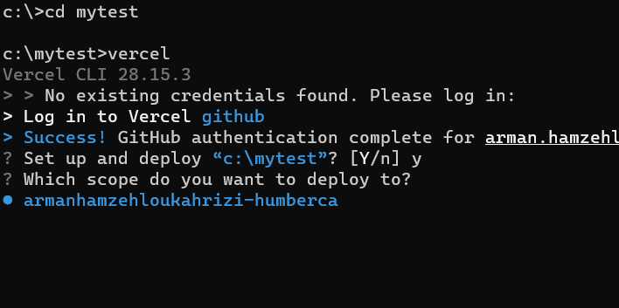
Step 6 - Scope
Confirm with “y” that you are setting up and deploying the project.
By default you will have one scope to deploy to. For now, choose the only available scope.

Slide 10
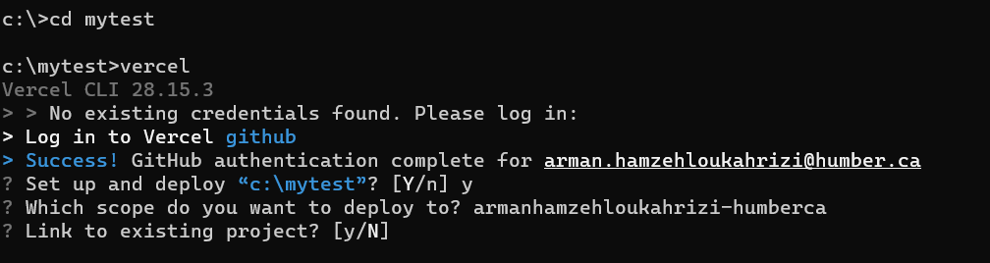
Step 7 - Linking
Decline by “N” to link to an existing project since you are deploying this project and a new project to your Vercel account.

Slide 11
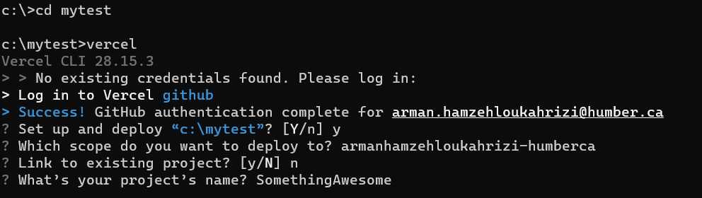
Step 8 – Project Name
Choose a project name for the app you are deploying.

Slide 12
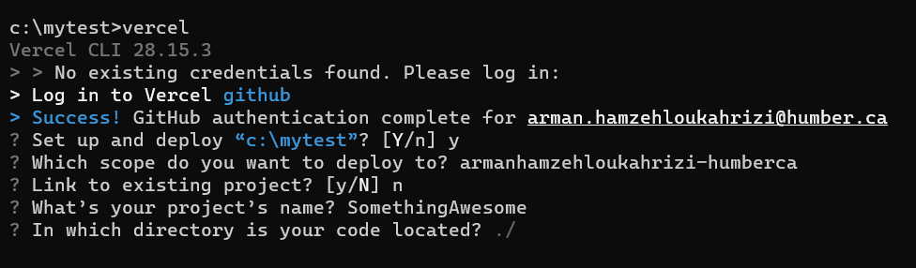
Step 9 – Project Directory
Leave the directory of the code to be ./
Simply press enter

Slide 13
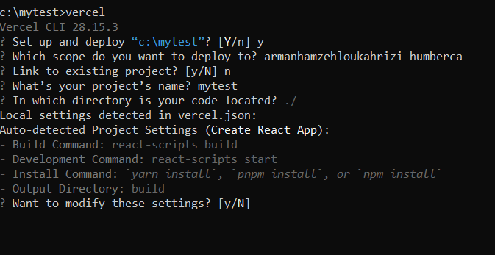
Step 10 – Project Settings
For now, you do not need to modify any of the commands. Simply decline with typing “N” and pressing enter.

Slide 14
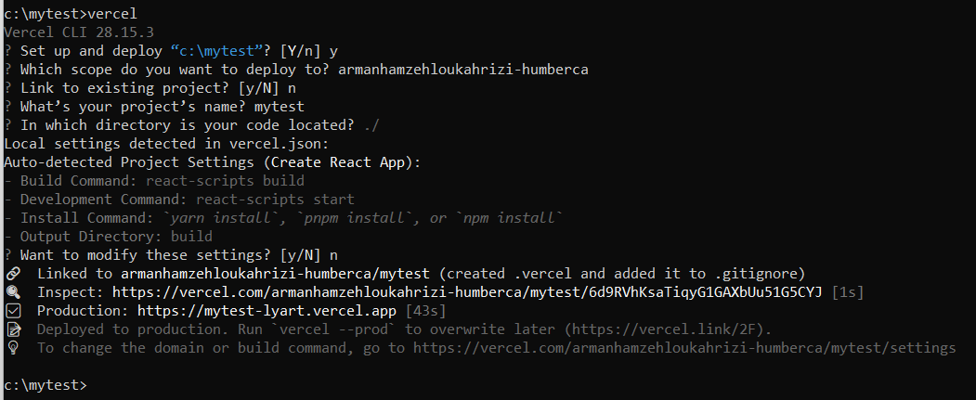
That’s it!
Try opening the Production URL!

